Slide 1
Candidate Pack

Slide 2
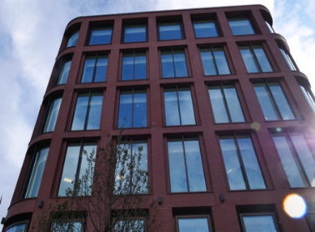
Welcome
Our Priorities
Senior Leadership Team
Beyond Whitehall
Employee Benefits
We are for everyone
Candidate Pack
Guaranteed Interview
Schemes
How to apply
Other information

Slide 3
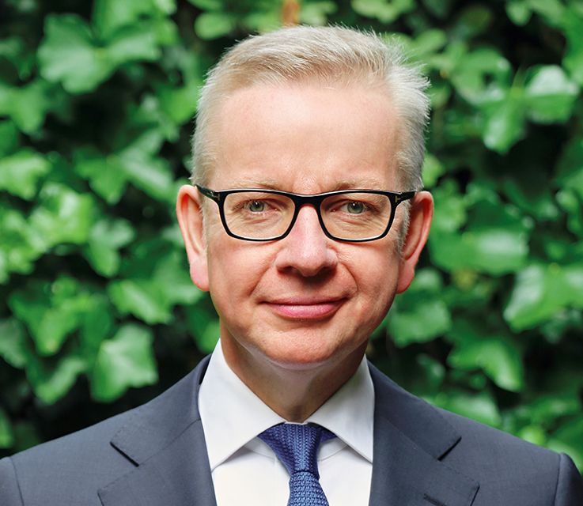
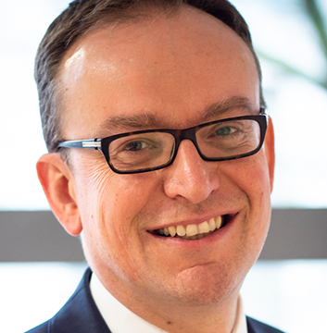
Welcome from the Secretary of State and Permanent Secretary
Levelling Up is the defining mission of this Government; we are reorienting our energy, resources and focus across the whole of Government to deliver a complete system change to level up the UK. It is clear that, while talent is spread equally across the United Kingdom, opportunity is not, and the Levelling up White Paper
sets out a detailed, comprehensive, measurable and ambitious plan to challenge and change these disparities. Achieving this step change in place-based policymaking cannot be done by central government alone; it requires real people, with a profound
understanding of their communities, to be involved
in the shaping of policy and delivery in their areas.
Our Department is at the forefront of the government’s central mission to drive forward the Government’s ambition of levelling up the country as we build back better from the pandemic. We have a critical role to play in building better quality, safer, greener and more affordable homes; ending rough sleeping; enabling a sustainable and resilient local government sector; and raising productivity and empowering places across all parts of the United Kingdom.
We are proud of the work we do, and of our open and collaborative culture. We want to empower and enable our people to deliver at their best. Central to this is our commitment to diversity, and to creating a truly inclusive working environment.
We are looking for people who can shape and deliver the strategies and plans that we will need to realise improved outcomes for people across the country. In return we’ll offer you a rewarding career and the chance to make a meaningful difference in your communities.
Above all, we are looking for people who want to make positive change happen. If you think this could be you, we look forward to hearing from you.
Michael Gove
Secretary of State
Jeremy Pocklington
Permanent Secretary

Slide 4
Our Priorities
Background
Our Priorities
Levelling up all parts of the country to create more opportunities, better jobs and boosting living standards
Delivering more, better quality, more affordable, safer and greener homes
Ending rough sleeping and reducing homelessness
Introducing the biggest changes in building safety for a generation
Supporting the sustainability of the local government sector that delivers priority services and empowers communities
Maintaining the Union, and ensure that its strength and benefits are clear, visible and recognised by all citizens
The Department for Levelling Up, Housing and Communities is at the heart of this Government’s agenda to level up all parts of the country. We have a broad and ambitious set of objectives, making sure that economic opportunity is spreading equally across the United Kingdom. We aim to fully realise our unique role in understanding local issues and how policy impacts people in communities - using this rich insight to influence national policy, with skill and confidence.
DLUHC has been at the forefront of the Government’s fight against Covid-19 at national and local level: by taking unprecedented steps to protect thousands of rough sleepers; in shielding the most vulnerable in society; and introducing a series of emergency measures to support people, places and sectors.
Now is the time for our focus to shift to helping the country recover and rebuild. Our mission to level up has never been more critical and we continue to make significant progress in delivering programmes for Government.
Our Priorities
Levelling up all parts of the country to create more opportunities, better jobs and boosting living standards

Slide 5
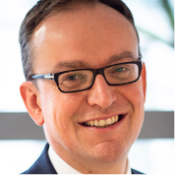
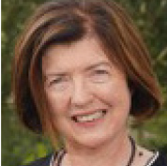
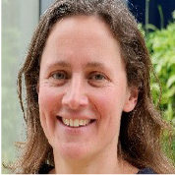
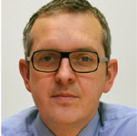
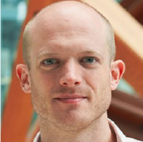
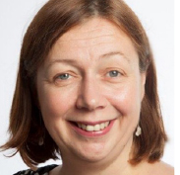
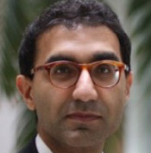
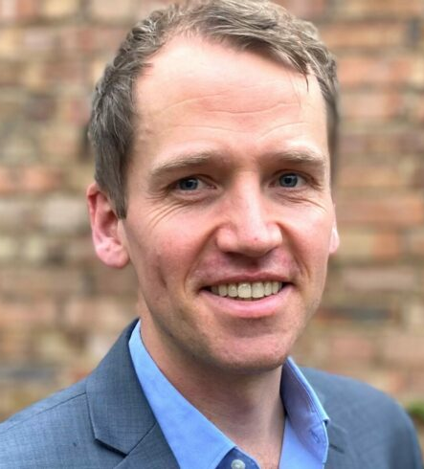
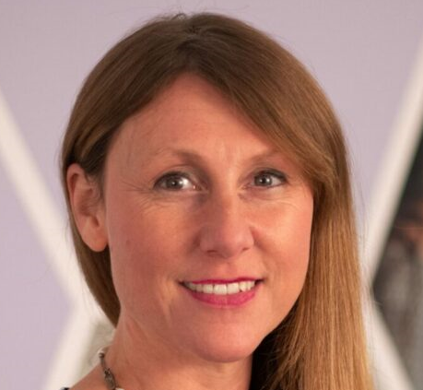
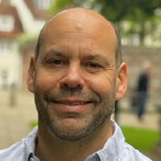
The Executive Team
Jeremy Pocklington
Permanent Secretary and Chair of the Executive Team
Sue Gray Second Permanent Secretary, Union, Elections and Places
Catherine Frances Director General, Local Government and Public Services
Matt Thurstan
Director General, Corporate Services
Richard Goodman
Director General, Safer and Greener Buildings
Tracey Waltho Director General, Housing and Planning
Emran Mian
Director General, Regeneration Group
Will Garton
Director General, Devolution and Local Growth
Sharon Sawers Director, Communications
Simon Claydon
Director, People, Capability and Change

Slide 6
Beyond Whitehall
Reflecting the communities that we serve
At DLUHC, we are committed to become an even more outward facing department that reflects the diverse communities that we serve. Beyond Whitehall is a Civil Service wide reform programme, which works to break down London centricity in how we develop and implement policy, and we are a leading department in its progress.
Leading the way
We are delighted that we have opened our second headquarters in Wolverhampton, where we are based
As the department for place, DLUHC is leading the way on this programme of work with a strong focus on building our presence in places for growth like our new offices in Wolverhampton, Darlington, Cardiff, Edinburgh and Belfast.
We have increased the number of people outside of London by almost 400 roles in the last year and a half, with over 30% of our staff now based outside London up from just over 20% in March 2020.
Alongside Wolverhampton, we have a new hub in the Northern Economic Campus in Darlington
As we continue to build on our Beyond Whitehall commitments, we will ensure a greater
in the i9 building within the historic heart of Wolverhampton City Centre. It will house 250 roles over
the next couple of years, and in a first for Government, it will have a regular and frequent ministerial
presence.
and a UK-wide presence in Belfast, Cardiff & Edinburgh whilst retaining our presence in each
of the nine English regions.
diversity of thought is reflected in the development and delivery of Government policy,
and greater career opportunities are promoted outside of London.

Slide 7
Employee Benefits
We have a variety of flexible working opportunities, including part-time or term-time working and access to Flexible Working Schemes allowing you to vary your working day. We also offer hybrid working, so you can mix office working from multiple locations and remote working.
We offer a Generous Annual Leave and Bank Holiday Allowance of 25 days annual leave on entry, increasing on a sliding scale to 30 days after 5 years’ service. This is in addition to 8 public holidays. This will be complimented by one further day paid privilege entitlement to mark the Queen’s Birthday.
A competitive contributory pension scheme. This is an average salary defined benefit scheme that you can enter as soon as you join and we will make a significant contribution to the cost of your pension. We also offer access to a staff benefits scheme which provides staff discounts, charitable payroll giving and, subject to eligibility, childcare vouchers and a cycle to work scheme.
Whatever your role, we take your career and development seriously, and want to enable you to build a really successful career with the Department and wider Civil Service. We also offer up to 6 days of volunteering leave.
We are diverse and inclusive, with strong and pro-active staff networks, special leave policies, reasonable adjustments put in place for those who need them, and diversity talent programmes to help everyone, irrespective of background, to achieve their potential.

Slide 8
We are for everyone
Everyone in DLUHC is unique and brings their own individual perspectives into our organisation. Our vision for DLUHC is to be a department with a workforce that is representative of a modern Britain.
We want to obtain the full benefits of our diverse employees; therefore, we strive to foster an inclusive culture where everyone has a sense of belonging, authenticity of voice and can thrive. Our “We are for everyone” campaign embodies our aspirations for Diversity”. We welcome applicants from all backgrounds and communities, and in particular those that are currently underrepresented in our most senior grades. This includes, but is not limited to, Black, Asian and Minority Ethnic (BAME) candidates, candidates living with disabilities, and female candidates.
Inclusion and Belonging
At DLUHC we are committed to providing a positive and inclusive environment where people are valued for the skills and experience, they bring. Trust, integrity, approachability will be encouraged and valued. We know that when our people are treated fairly and feel included, they are more motivated and deliver better outcomes for the public.
Staff Networks
In DLUHC, we have plenty of active employee network groups helping to support the creation of a more inclusive culture in our organisation. We also have a vibrant community of inclusion allies who ensure diversity and inclusion is driven across all our Directorates
Health and Wellbeing
We prioritise wellbeing in DLUHC because we know that our people are the key to our success. We have Mental Health Ambassadors and supply mental health first aid training, Wellbeing Champions across DLUHC and train all of our senior leaders to be Wellbeing Confident. We have an Employee Assistance Programme for all staff, as well as the use of the Calm app for free.

Slide 9
Guaranteed Interview Schemes
All candidates who are eligible and meet the minimum standard for a role progress to the next stage of selection under the following schemes. The minimum standard is the combination of experience, behaviours, strengths, abilities and technical/professional skills that a candidate will need to perform effectively in the role. All appointments into the Civil Service will be made on merit.
Disability Confident Scheme
As an employer we are committed to promoting and protecting the physical and mental health and well being of all our colleagues and applicants
If you feel that you may need a reasonable adjustment to be made, or you would like to discuss your requirements in more detail, please contact recruitment@levellingup.gov.uk in the first instance.
A Great Place to Work for Veterans
Veterans are defined as anyone who has served for at least one day in Her Majesty’s Armed Forces (Regular or Reserve). To be defined as a veteran they must be in transition from or ceased to be a member of Her Majesty’s Armed Forces. To be eligible to apply for roles under the initiative, veterans must meet certain eligibility criteria.
Redeployment Interview Scheme
The Scheme applies to all civil service employees at all grades, including Senior Civil Servants (SCS) in Departments and Crown Arms Length Bodies (ALBs), who are at risk of redundancy.
Prospective applicants will be eligible to use the scheme from the point they become at risk of redundancy up until the time they leave the department, either due to the redundancy or because they secure an alternative role.
DLUHC operates the Disability Confident Scheme (DCS) to help widen employment opportunities for disabled people. All Disability Confident Scheme applicants who meet the minimum standard are invited to attend interview. Applicants with a neurodivergence can apply under the Disability Confident Scheme. This includes; Attention deficit disorders, Autism (including Asperger’s), Developmental coordination disorder (previously known as Dyspraxia).
For more information on the Disability Confident Scheme please click here
To be eligible for this scheme in the Civil Service, a veteran must:
have served for at least one year in Her Majesty's Armed Forces (as a Regular or Reserve);
not already be a Civil Servant, or be employed by a Civil Service Commission
accredited public body.
There is no maximum time limit from when an individual left Her Majesty’s
Armed Forces to be eligible for this initiative.
For more information on the Great Place to Work for Veterans Scheme please click here
It applies to all vacancies, whether they are advertised internally or externally
be in transition from, or ceased to be a member of, Her Majesty’s Armed Forces; and

Slide 10
How to apply
DLUHC use the Civil Service Success Profiles framework. The Success Profile Framework is a flexible framework which assesses candidates against a range of selection methods, ensuring we give the best possible chance of finding the right person for the job.
Success Profiles is made up of 5 elements;
Experience
Ability
Behaviours
Strengths
Technical
Read more about the Success Profile framework here.
When applying for a role, make sure to look at the job
description which will detail the elements of the Success
Profiles you are being assessed against for that role.
Top Tips
When using Success Profiles, we would recommend the STAR model to structure your answers. We find this allows you to best demonstrate your skills and experience, so we can get to know you.
Situation (what was the setting and conditions, and what was your role)
Task (what specifically needed to be done when, why, etc.)
Action (what did you do in terms of your own contribution and ensuring the contribution of others, how you did it and why)
Result (What the outcome was and how you contributed to it what difference did you make)

Slide 11
Other Information
Security Clearance
All DLUHC colleagues must meet the Baseline Personnel Security Standard. This is a series of basic security checks to confirm identity and employment history.
In addition to the BPSS, all staff based at our Marsham Street office in London (and some based in our other offices) must be cleared to at least Counter Terrorism Check level. It is a requirement of some roles at Marsham Street and other DLUHC offices that the holder obtain either Security Check or Developed Vetting clearance. Each vacancy will state the level of security required for the post. The nature and level of the security checks will vary subject to the level of clearance required.
For more details of vetting levels and requirements please refer to the Cabinet Office HMG Personnel Security Controls.
All offers of employment are conditional on successful completion of BPSS and (if applicable) National Security Vetting. Candidates should not resign from their current job until these checks have been successfully completed.
If you have any questions or queries with regards to any of these areas please contact the HR Shared Service Centre at HRsharedservices@levellingup.gov.uk.
Appeals and Complaints
If you are unsure about any part of the process or require additional information about the post to enable you to progress your application, you should speak to the Resourcing team recruitment@levellungup.gov.uk
Candidates can appeal at any stage of the recruitment process if they believe there has been:
A procedural irregularity
An infringement of the Civil Service equal opportunities policy
Exceptional circumstances which were not notified to the interview panel which might have affected performance on the day
It is importance to note that these are appeals about the process not the decision. In the first instance, an appeal should be directed to the DLUHC Resourcing Hub at recruitment@levellingup.gov.uk .
If the DLUHC Resourcing Hub is unable to satisfactorily resolve your complaint, you may contact put your complaint in writing to the Civil Service Commission, Room G8,1 Horse Guards Road, London, SW1A 2HQ or by email to: info@csc.gov.uk

Slide 12
Civil Service Nationality Requirements and Internal Fraud Database
Before starting your application, it’s very important to make sure that you are eligible to apply and meet the Civil Service nationality requirements. DLUHC roles are open to:
UK nationals
Nationals of Commonwealth countries
Nationals of the Republic of Ireland
EEA nationals with (or eligible for) status under the EU Settled Status Scheme
Relevant EEA or Turkish nationals working in the Civil Service
Relevant EEA or Turkish nationals who have built up the right to work in the Civil Service
Certain family members of the relevant EU & Turkish nationals
Details of who is eligible to work in the Civil Service are set out in the Civil Service Nationality Rules. All candidates are expected to read the information provided in the links below regarding the nationality requirements and rules.
Civil Service Nationality Rules
Countries in the EU and EEA
As part of your application you will be asked to confirm that you have read all the information provided in the links above and
confirm that you meet the nationality requirements. If you are unsure if you meet the nationality requirements for this role please contact DLUHC’s HR Service Centre at HRSharedServices@levellingup.gov.uk. It is a criminal offence for candidates to not disclose the truth on their job application with the intention to secure employment. If you do not meet the nationality requirements for this role but declare otherwise, any offer of employment will be withdrawn immediately.
The Internal Fraud function of the Fraud, Error, Debt and Grants Function at the Cabinet Office processes details of civil servants who have been dismissed for committing internal fraud, or who would have been dismissed had they not resigned.
The Cabinet Office receives the details from participating government organisations of civil servants who have been dismissed, or who would have been dismissed had they not resigned, for internal fraud. In instances such as this civil servants are then banned for 5 years from further employment in the civil service.
The Cabinet Office then processes this data and discloses a limited data set back to DLUHC as a participating government organisations. DLUHC then carry out the pre-employment checks so as to detect instances where known fraudsters are attempting to reapply for roles in the civil service. In this way the policy is ensured and the repetition of internal fraud is prevented..
For more information – please see the internal fraud register page.

Slide 13
Further Information
Further Information on working for DLUHC
To find out more information on DLUHC and what we are trying to achieve, including publications and transparency releases, please do look at our website which can be found here:
https://www.gov.uk/government/organisations/department-for-levelling-up-housing-and-communities
Our Outcome Delivery Plan sets out our priority outcomes and strategic enablers and how we will achieve them.:
https://www.gov.uk/government/publications/ministry-of-housing-communities-and-local-government-outcome-delivery-plan
Our latest Annual Report and Accounts provides a comprehensive account of the Department and its group’s use of resources during the financial year 2019 to 2020 and information about its activities and performance against its objectives. This can be found here:
https://www.gov.uk/government/publications/DLUHC-annual-report-and-accounts-2019-to-2020
The Levelling Up White Paper sets out how we will spread opportunity more equally across the UK. This can be found here: https://www.gov.uk/government/publications/levelling-up-the-united-kingdom
Further information on working for DLUHC can be found on our page on the new Civil Service careers website:
https://www.civil-service-careers.gov.uk/departments/working-for-the-department-for-levelling-up-housing-and-communities/
Further information on working in the Civil Service
The Civil Service provides services directly to people all over the country, including:
• paying benefits and pensions;
• running employment services;
• running prisons; and
• issuing driving licences.
We also have staff working on policy development and implementation, including analysts, project managers, lawyers and economists.
To find out more information on working in the Civil Service, please look at the Civil Service website here:
https://www.gov.uk/government/organisations/civil-service/about/recruitment
The Civil Service Code sets out our core values and the standards of behaviour expected of all civil servants and this can be found here:
https://www.gov.uk/government/publications/civil-service-code
The Civil Service Workforce Plan provides a strategy for how the Civil Service will share and provide improved outcomes for effective leaders and skilled people who support the nation as civil servants. This can be found here:
https://www.gov.uk/government/publications/civil-service-workforce-plan-2016-to-2020
The new Civil Service Careers website can be found here:
https://www.civil-service-careers.gov.uk/

